Slide 1
Precious pearls urban leadership academy
Ppula

Slide 2
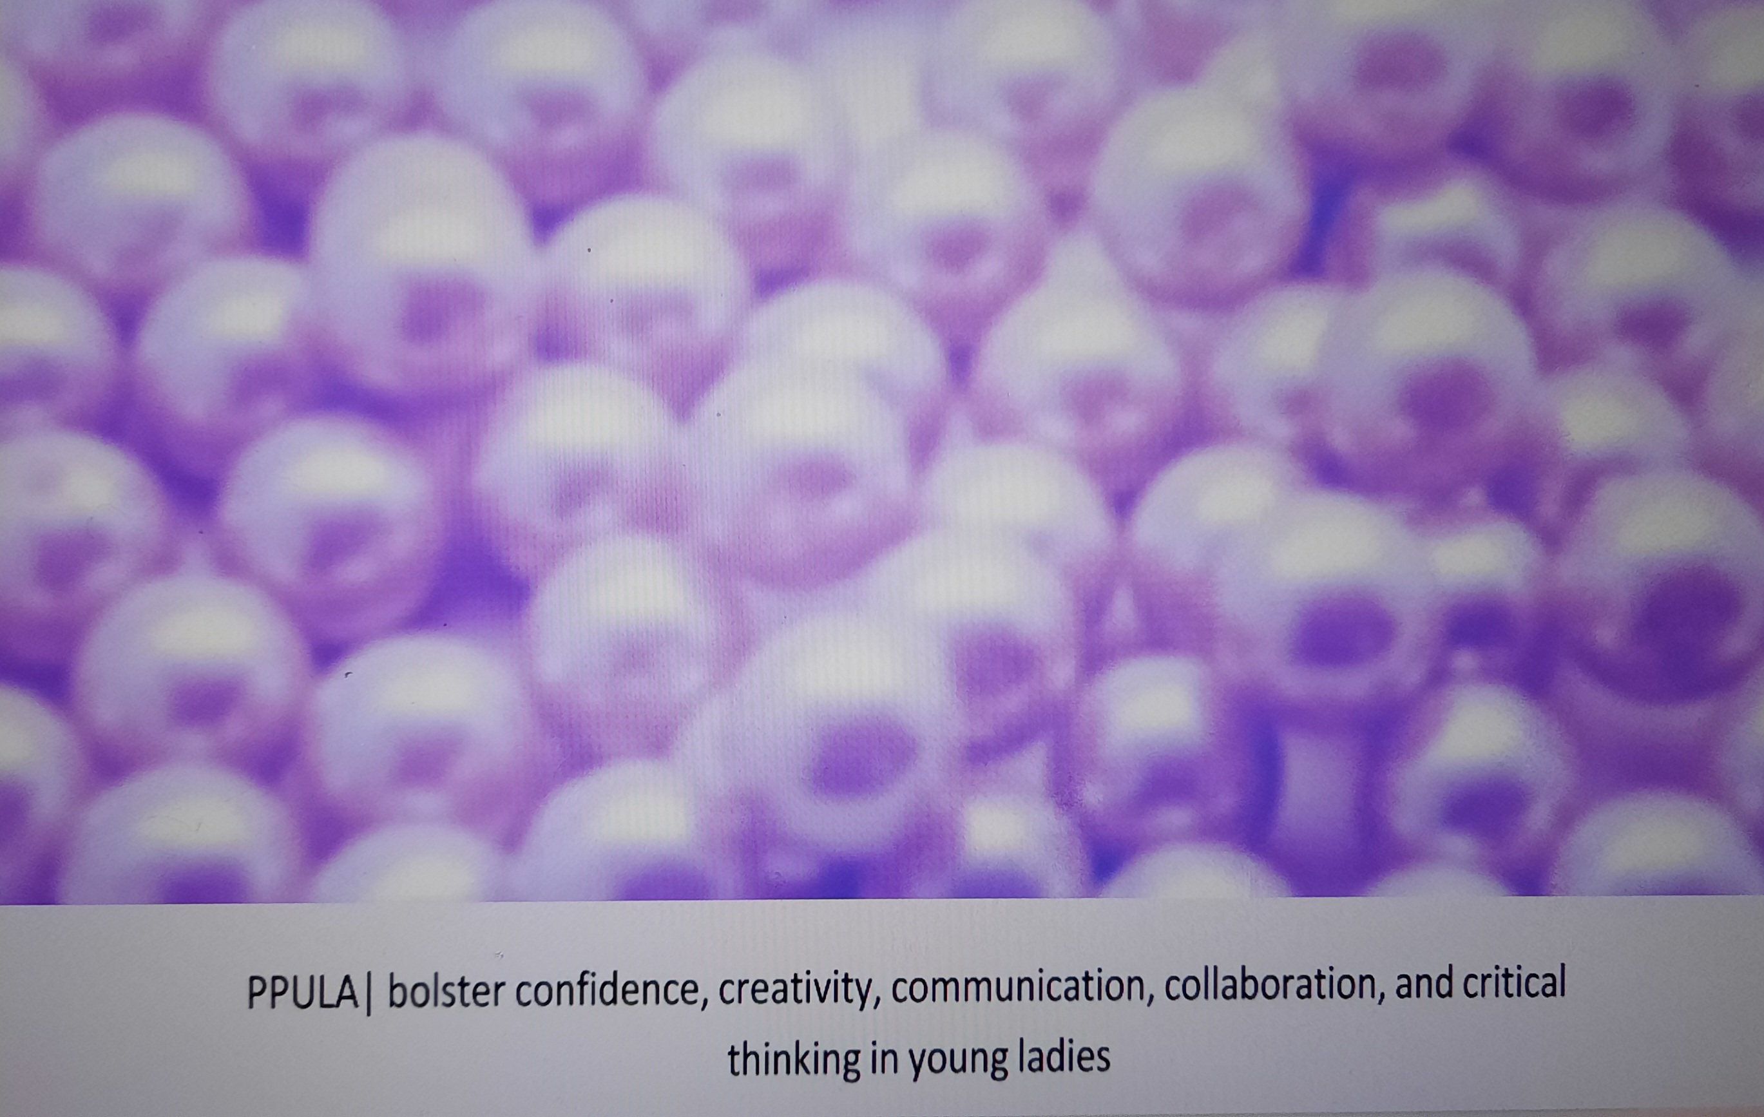

Slide 3
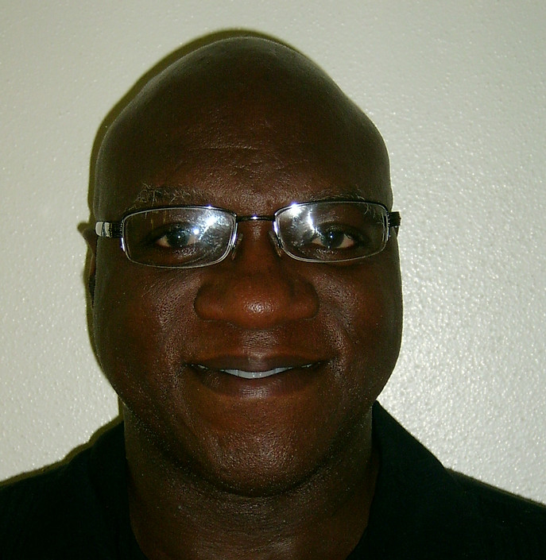
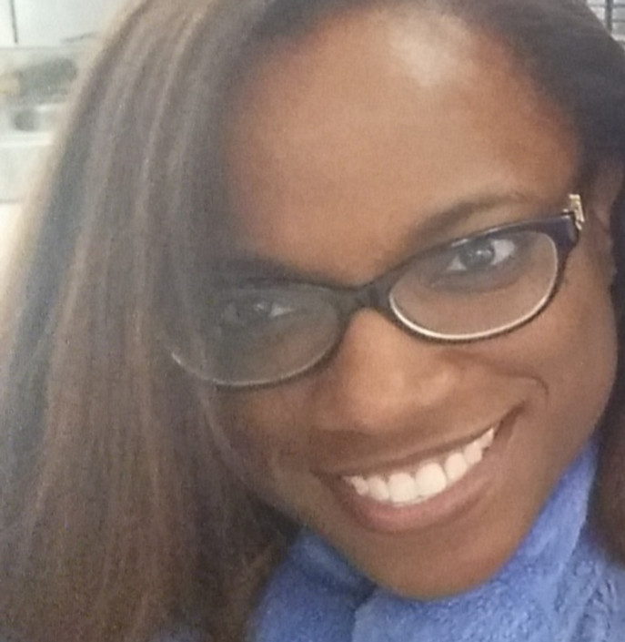
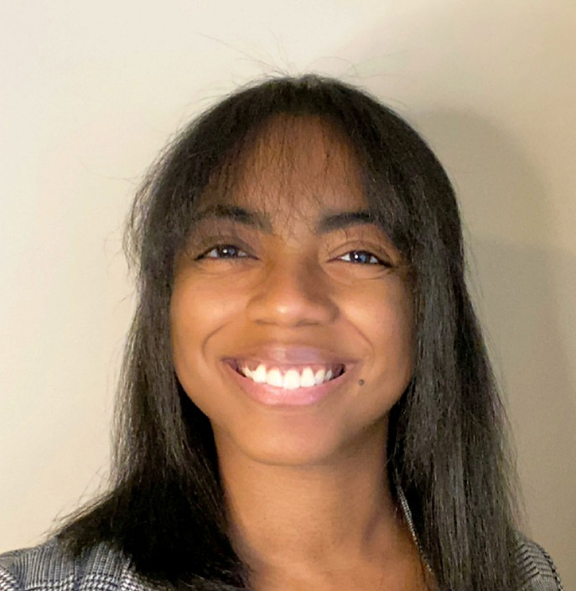
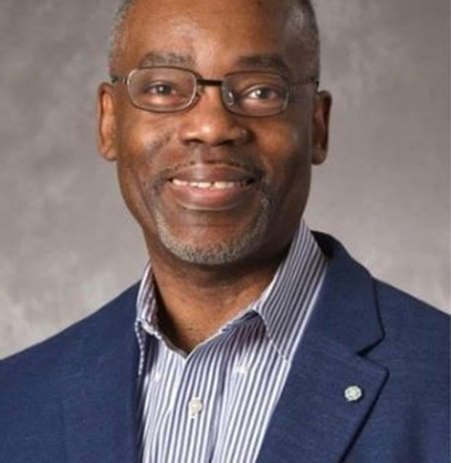
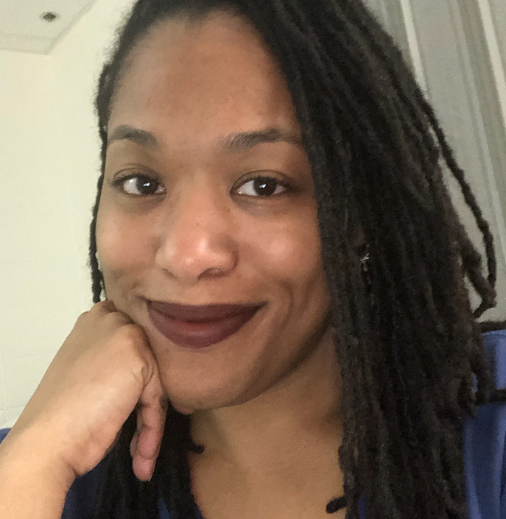
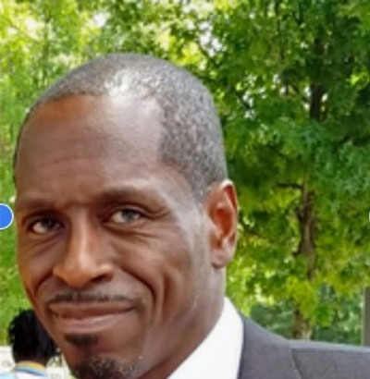
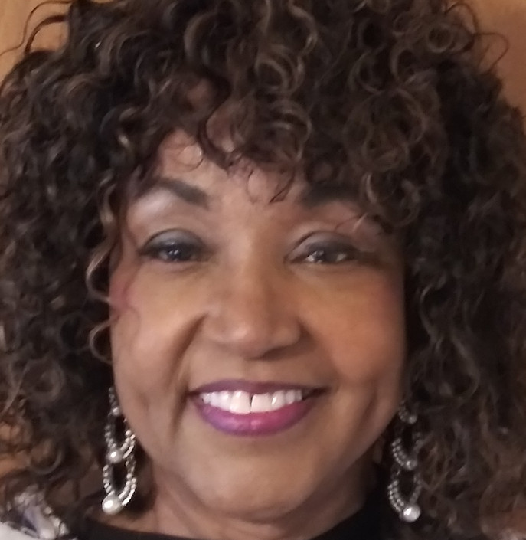
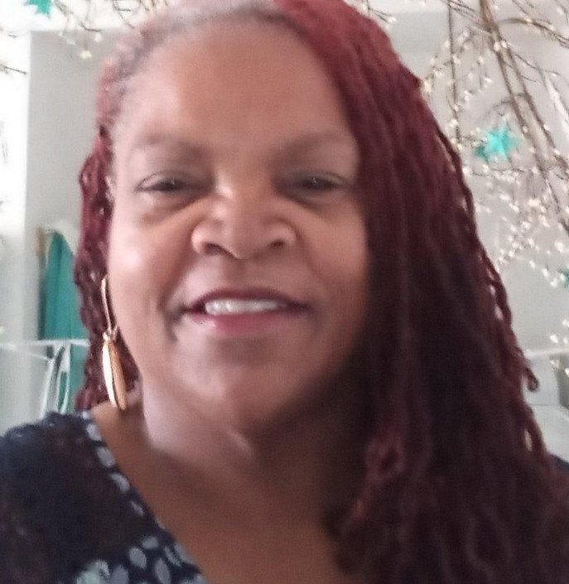
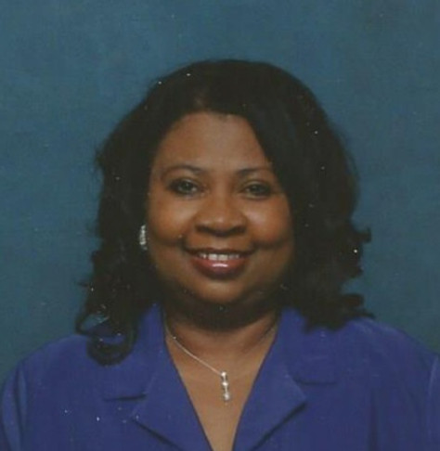
Board Members
Top (left to right) – President, Tommy Hamilton; ceo, Yalonda jones; secretary Charlene jones; cfo, julian pouncy; vice president, Stephanie hosley bottom (left to right) – member, Keith butler; member, Diana martin; member, Camille Douglas; member, Barbara jones

Slide 4
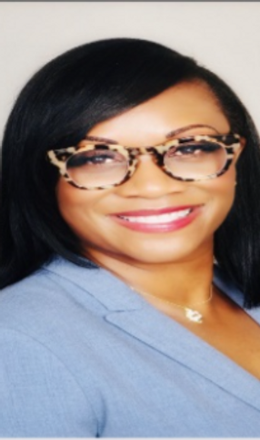
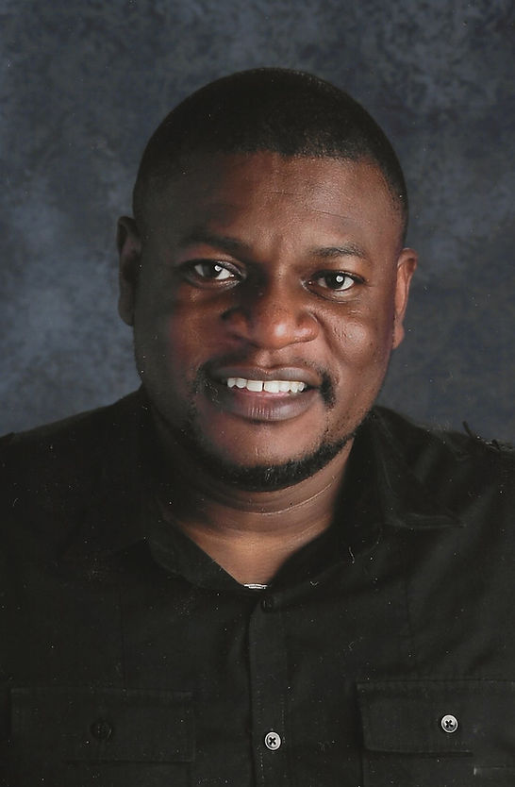
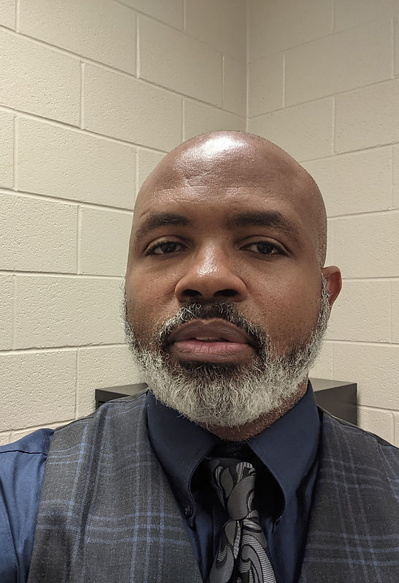
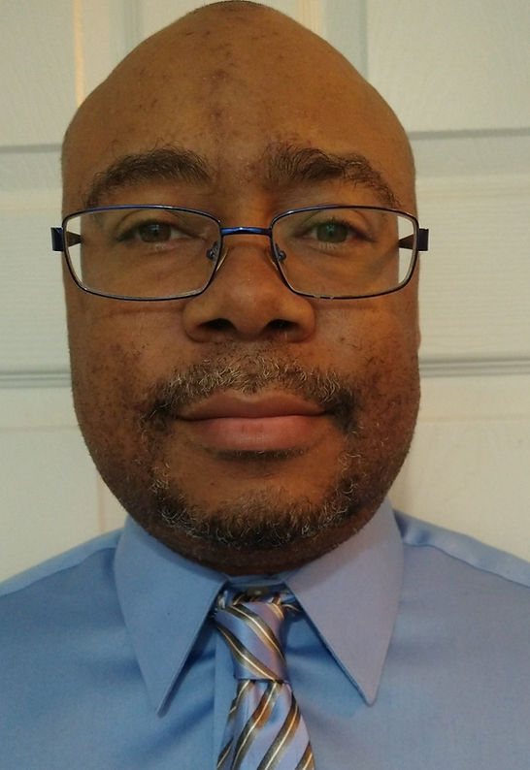
Staff
Top (left & right) – director/ceo, Yalonda jones; assistant director, Samantha Williams bottom (left & right) – associate director of ctae, al gosha; financial manager, Stephen hayes center – Associate director of math and science, Samuel olawilliam

Slide 5
Why precious?
of great value or high price
highly esteemed or cherished
excessively refined
GREAT
  Best friend’s catch phrase
  https://www.merriam-webster.com/dictionary/precious

Slide 6
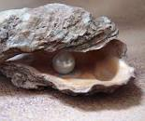
Why pearls?
Pearls are truly one-of-a-kind, especially when you consider that they are the only gemstones to come from a living creature. Mollusks such as oysters and mussels create pearls. In freshwater rivers and ponds, mussels produce pearls, while in saltwater they are produced by oysters.
The process begins when a particle, or what is referred to as an irritant, gets inside the mollusk. This particle in essence functions as the nucleus of the pearl from a very early stage. Once the irritant becomes trapped, the mollusk begins to coat to it with nacre as a defense mechanism. Nacre is a composite made mostly of aragonite that is strong and iridescent. The unique luster (or glow) of pearls comes from this nacre. The mollusk coats the nucleus with thousands upon thousands of layers of nacre, and over time, a pearl begins to slowly form.
  https://www.thepearlsource.com/facts-about-pearls/how-are-pearls-made.php

Slide 7
Why urban?
Reach inner city youth otherwise not afforded opportunity for high quality education
  the area near the center of a city, especially when associated with social and economic discourse and division

Slide 8


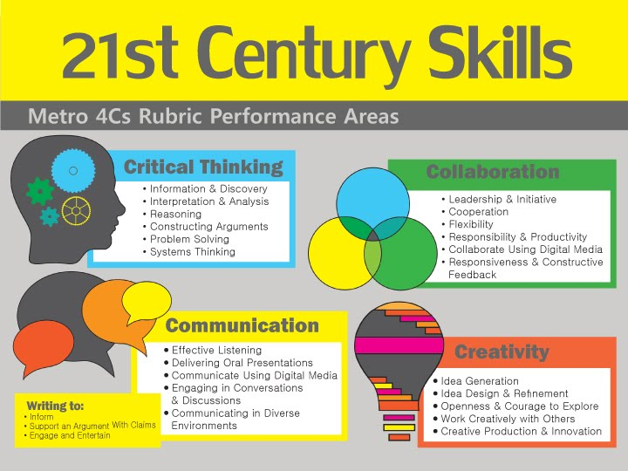
Why leadership?
We are creating productive, conscious, & effective world leaders with 21st century skills
  Critical thinking.
  Creativity.
  Collaboration.
  Communication.
  Information literacy.
  Media literacy.
  Technology literacy.
  Flexibility.

Slide 9
Why academy?
a place of study or training in a special field
a society or institution of distinguished scholars and artists or scientists that aims to promote and maintain standards in its particular field

Slide 10
What is it?
Charter school
Gender based (female)
Year round
Empowering; motivating; encouraging
Teacher safe; parent friendly; student centered

Slide 11
Why is it?
Vision given to director/ceo in a dream in 2002 (began as preschool ideology)
Men and women of distinction (Group director/ceo started at a local high school in 2008/2009)
  Mentorship; tutoring; guest speakers; lunch; scholarships; partnership; college visits
Offer alternative education opportunities
There is a need
  Achievement gap
Director/ceo dissertation
  Address achievement gap; focus on what works

Slide 12
Public status
Petitioner assures that the Charter School shall be a public, nonsectarian, nonreligious, nonprofit school organized and operated under the laws of the State of Georgia. Petitioner further assures that the Charter School shall not be home based.

Slide 13
Community member participation
Mrs. juliee vanhorse

Slide 14
contact us
Website
  Preciouspearlsurbanleadershipacademy.com
Email
  Preciousheros@gmail.com

